Slide 1
Reducing GHG Beef farms
Certified Irish Angus

Slide 2
GHG emissions
Agriculture accounts for approximately 38.4% of Irish greenhouse gas production.(EPA,2022)
The three main greenhouse gasses from agriculture are:
Methane - From rumen fermentation and slurry storage. Methane is 25 times more potent than carbon dioxide. It accounts for almost 2/3 of agricultural GHGs.
Nitrous Oxide - From organic and chemical nitrogen fertiliser and excreted N. It is 300 times more potent than carbon dioxide. It accounts for almost 1/3 of agricultural emissions
Carbon Dioxide - Associated with the use of fossil fuels for energy and the manufacture of fertiliser. It accounts for a relatively small proportion of agricultural emissions
The Irish grass-based beef production systems are relatively carbon efficient.

Slide 3
How do the GHGs cause an increase in temperature?
GHGs act like a blanket around the Earth.
Heat from the sun reflects off the Earth and is trapped by layers of these gases in the atmosphere.
Without this, the Earth would be frozen.
Increased amounts of GHGs in the atmosphere in recent decades have meant that more heat is trapped within the atmosphere, leading to the so-called greenhouse effect.
This has caused global temperatures to rise, which causes climate change.

Slide 4
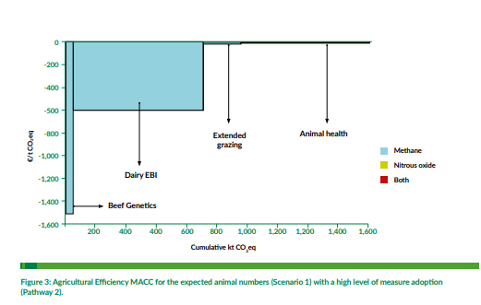
What is the MACC
MACC stands for Marginal Abatement Cost Curve
It is a graphical representation of measures that farmers can implement to reduce GHG emissions
It is a useful way to understand the cost effectiveness of the different GHG reduction measures

Slide 5
MACC
The further right you move the measures are cost prohibitive (Reduce GHG emissions but cost money to implement.)
The curve is laid out so that the most beneficial (Reduce GHG & save money) to the left-hand side of the graph.
€ € € €’s
The depth of the bar represents the cost saving the farmer can make. The deeper the bar the greater the “€” saving.
The width of the bar represents how much GHG can potentially be saved. The “wider” the bar the greater the GHG saving

Slide 6
By reducing age of slaughter by 1 month
Profit
Emissions
Increased profitability by approximately €30/head
CO₂e reduced by approximately 350 kg CO₂e/head.
Better grassland management
Make better quality silage.
Use early maturing breeds and cattle with good ICBF figures

Slide 7
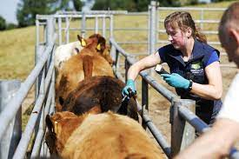
Improve animal health
Profit
Emissions
Reducing health problems will improve efficiency, reduce costs and increase profitability
Improvements in health will reduce GHG emissions per unit of meat. Reduces footprint
Create health, plan/vaccination programme.
Implement good stock importing practices

Slide 8
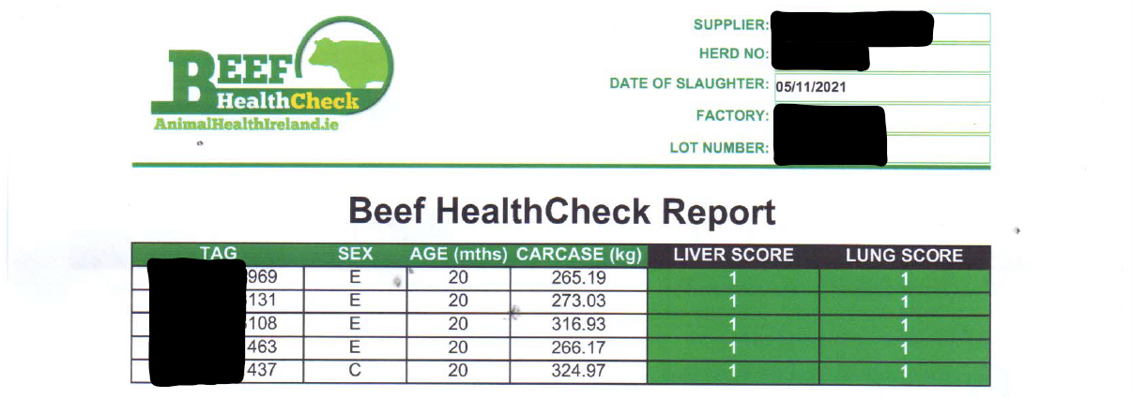
Beef Health Check
For every batch of cattle slaughtered the farmers will receive a report indicating a disease score relating to any liver and lung conditions present at slaughter.
This allows the farmer asceses how well their heard health plan is working
Beef HealthCheck Batch Report example

Slide 9
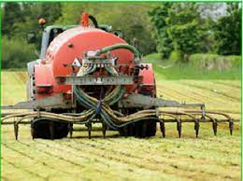
Low emissions slurry spreading
Profit
Emissions
Retains an extra 3 units of N/1,000 gallons of cattle slurry.
Reduces ammonia emissions from slurry by up to 30% and nitrous oxide emissions through reduced chemical N use.
Create health, plan/vaccination programme.
Implement good stock importing practices

Slide 10
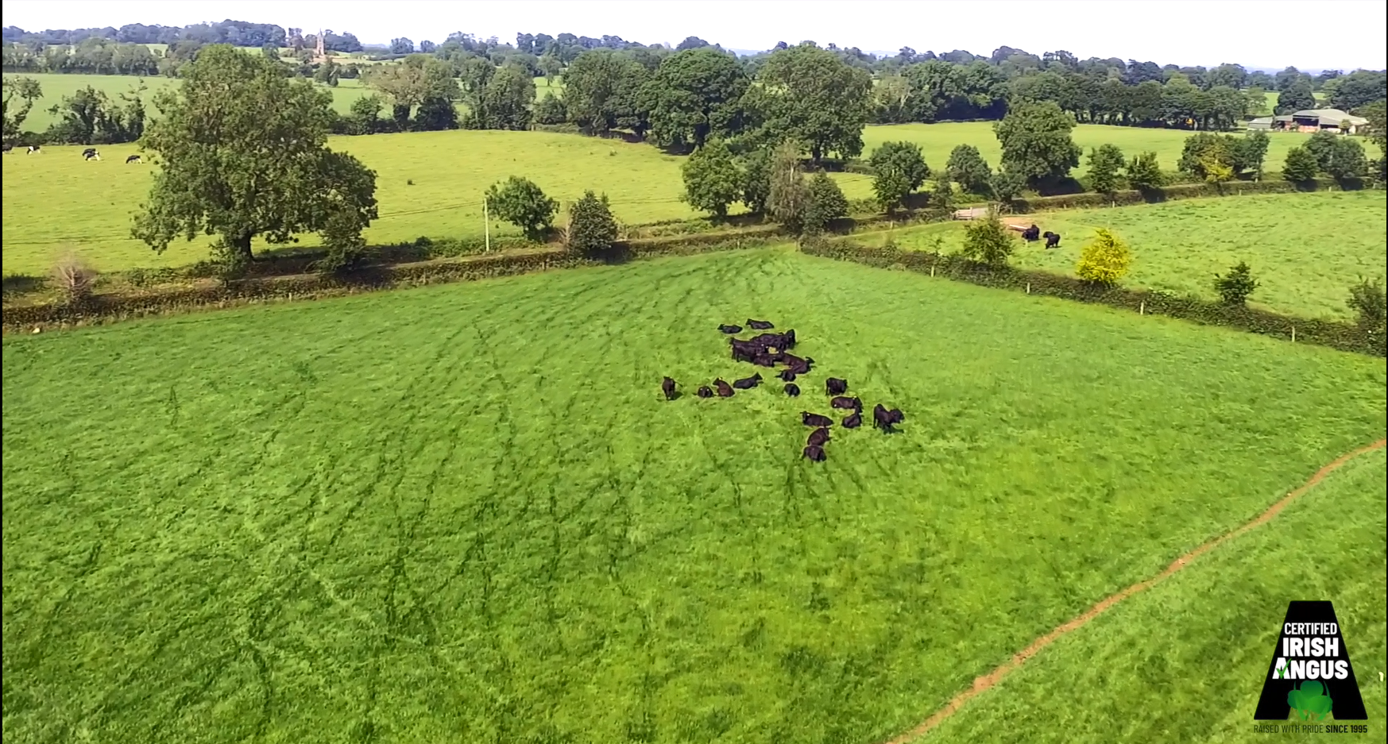
Grazing management
Profit
Emissions
Every extra tonne of grass dry matter (DM) grown and utilised/ha is worth €105 to the beef farmer
Reduces methane and nitrous oxide emissions. Reduces footprint
Walk your farm weekly
Measure grass
Use PastureBase Ireland
Improve infrastructure
Avoid poaching

Slide 11
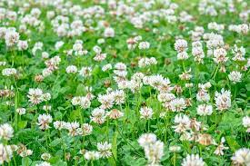
Incorporate white clover
Profit
Emissions
Profitability increased by 14% greater for the grass/clover system when compared to a ‘conventional’ pasture
Nitrous oxide emission reduction is achieved from lower chemical N fertiliser use (up to 100 kg N/ha)
Over a 5 year period, aim to have white clover in at least 30% of your paddocks (at a minimum average annual sward clover content of 20%)

